Slide 1
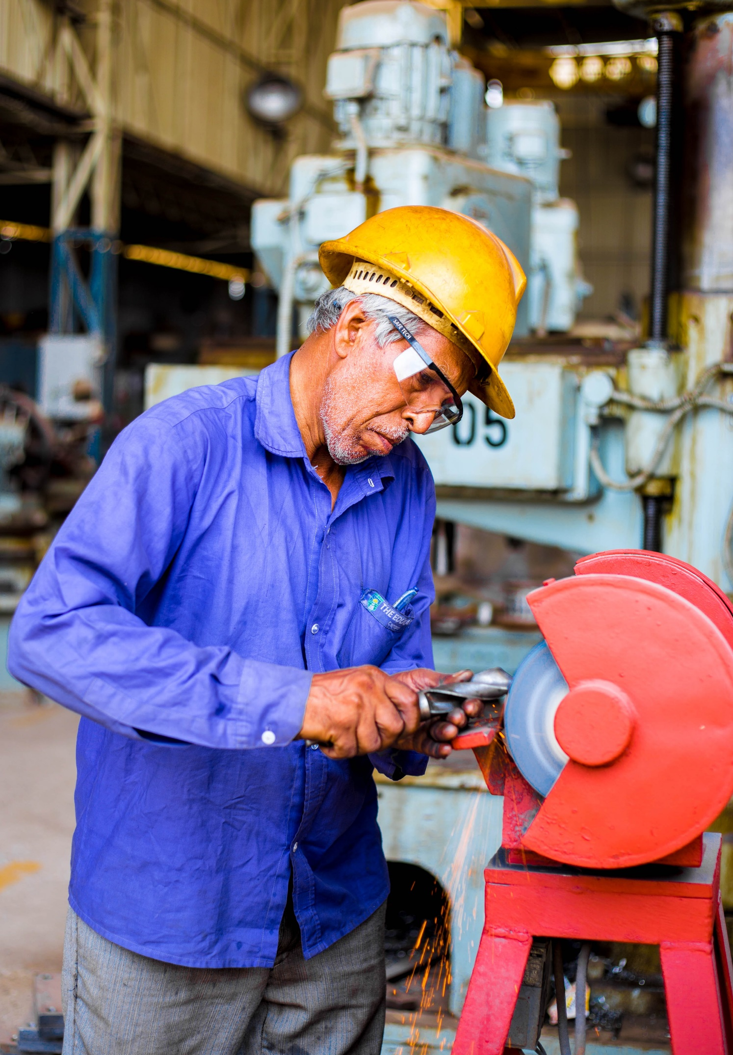

Identifications and Solutions for the Aging Workforce in Malaysia
WQD7004 Programming for Data Science Group 2 - AUTUMN
Name | Matric ID
Wong Jia Hui | S2192852
Danial Mirza Bin Madrawi | 22062607
Low Boon Kiat | 17138399
Hongsheng Jie | 22064728
Yuejing Huang | S2158553

Slide 2

Table of Content
01
Introduction
06
Data Cleaning
02
07
Exploratory Data Analysis (EDA)
Objective
03
Methodology
08
Modeling
04
Data Understanding
09
Discussion
05
Data Preparation
10
Conclusion

Slide 3
Introduction
World Elderly Population
Decline in birth rate
Increased life expectancy
1.4 billion by 2030
2.1 billion by 2050
(Source: United Nations).
Aging workforce
This project focuses on identifying the trends of aging workforce in Malaysia and discusses how Malaysia could address the challenges arise from aging workforce based on the collected time-series data starting from year 1982 to year 2021.
A predictive model will also be proposed for predicting unemployment rate and growth rate of aging workforce in Malaysia.

Slide 4
Objective
To develop a predictive model for predicting unemployment rate and growth rate of aging workforce.
02
To identify trends of aging workforce in Malaysia.
01
To propose mitigation measures to address aging workforce challenges.
03

Slide 5
Methodology
Define Problem
Data Collection
Data Understanding
Data Preparation
To determine if Malaysia is encountering aging workforce issue
Download Raw Dataset from Ministry of Statistics Malaysia website.
Understand the definition of each columns, identify if there are null values or missing data.
Datasets integration, renaming columns, data structure transformation
Results and Discussion
Modeling
Exploratory Data Analysis
Data Cleaning
Communicate our findings and solutions to the stakeholders or audience.
Apply appropriate machine learning techniques to build predictive or explanatory models.
To perform descriptive and visual analysis of data to uncover hidden patterns, trends, relationships, and insights.
Null values were replaced with value using Linear Model.

Slide 6
Data Understanding
Raw Data
All the raw data sets are downloaded from https://www.dosm.gov.my/portal-main/time-series
A total of five (4) different raw data sets are used in this project.
Data Description & Data Quality
Name of Raw Dataset | Description | Comments on Data Quality
No.19 - Population | Data on Malaysia population, life expectancy and birth rate (1892 - 2019) | Missing data for year 2020 and year 2021
No.1 - Employed persons by age group, Malaysia/states | Data on number of employed person by age group in Malaysia (1982 - 2021) | Missing data for year 1991 and year 1993
No.9 - Labour force by age group, Malaysia/states | Data on number of labour force by age group in Malaysia (1982 - 2021) | Missing data for year 1991 and year 1993
No.18 - Principal statistics of the labour force by sex, Malaysia | Data on number of labour force and employed person by sex in Malaysia (1982 - 2021) | Missing data for year 1991 and year 1993

Slide 7
Data Preparation
Since multiple raw datasets are acquired, data extraction and data integration is required.
A dataset, df is created and ready for data cleaning process.
Column Name | Description
year | Year for collected data
m_lf | Male labour force (in thousand)
f_lf | Female labour force (in thousand)
m_employed | Male employed person (in thousand)
f_employed | Female employed person (in thousand)
age0-14 | Population under the age of 0 - 14 (in thousand)
age15-59_lf | Labour force under the agoe of 15 - 59 (in thousand)
age60-64_lf | Labour force under the age of 60 - 64 (in thousand)
age15-59_employ | Employed person under the age of 15 - 59 (in thousand)
age60-64_employ | Employed person under the age of 60 -64 (in thousand)
age65+ | Population above the age of 65
m_life | Male life expectancy
f_life | Female life expectancy
br | Birth rate (in %)

Slide 8
Data Cleaning
There are 27 NAs in data frame. The NAs were imputed by using linear regression model to predict each NA based on its neighboring data.
Identify NAs
Use for loop iteration and is.na() function to identify NAs.
Create subsets
Each time we locate a NA, create a subset named fit_data which includes two preceding rows and two succeeding rows.
Predict NAs
Apply predict() function to obtain a predicted value for the NA.
Compute linear model
Use lm() function to compute a linear model for fit_data. For this linear model, column with NA is outcome variable whereas “year” is predictor variable.

Slide 9
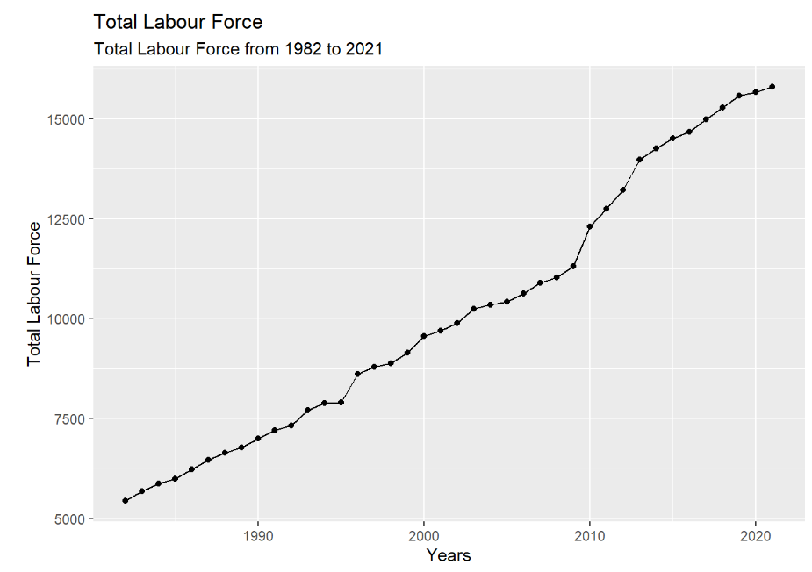
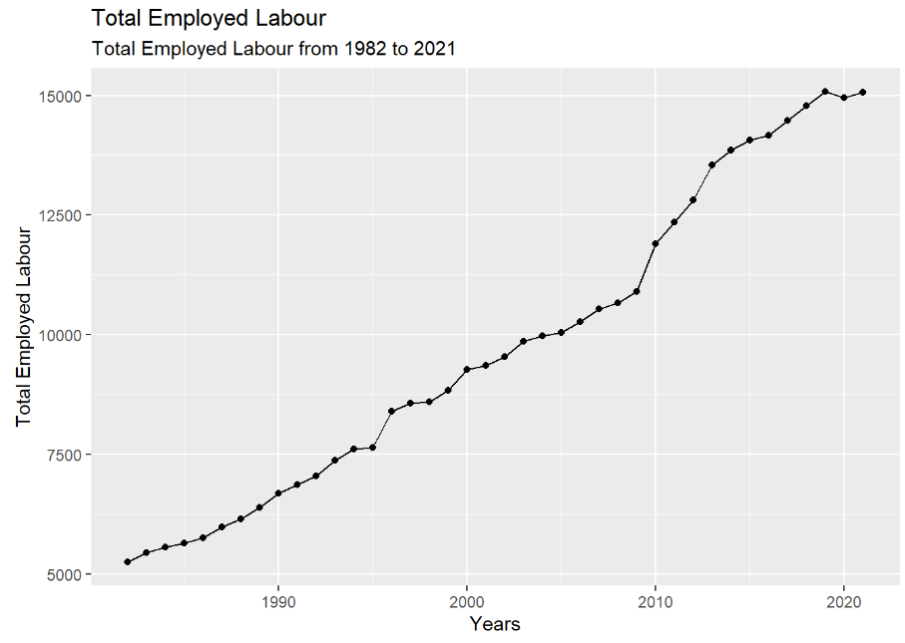
Exploratory Data Analysis (EDA) (1/5)
Employed data visualization techniques to identify key trends.
Total Labour Force by Year
01
Total Employed Labour by Year
02
Total Labour Force in Malaysia has been increasing from 1982 to 2021.
The Total Employed Labour Force in Malaysia has been increasing from 1982 to 2019 but stagnant since 2020

Slide 10
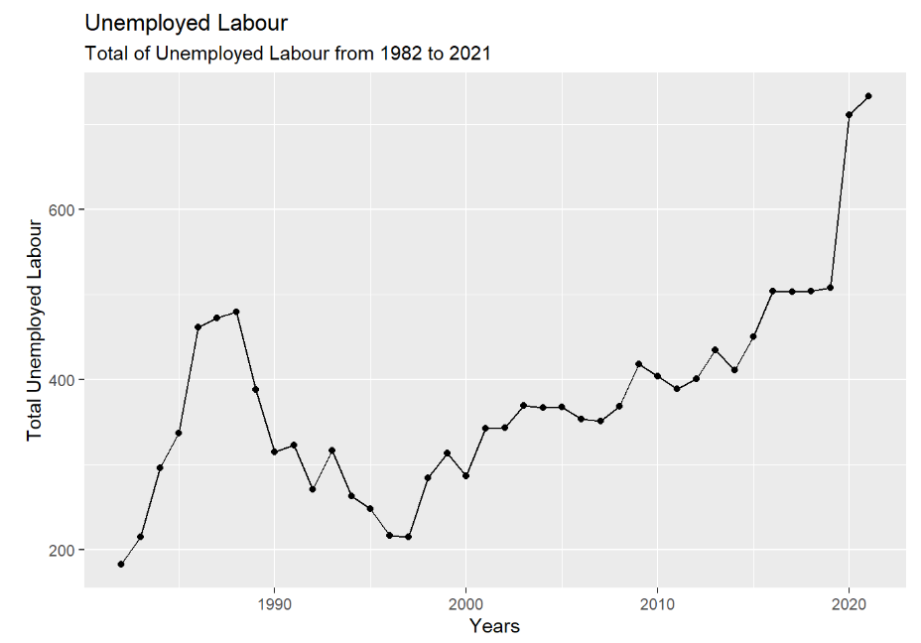
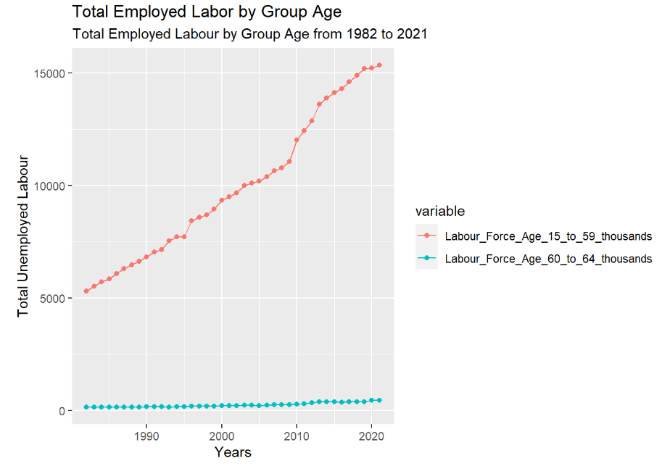
Exploratory Data Analysis (EDA) (2/5)
Total Unemployed Labour by Year
Total Employed Labour by Age
03
04
The Total Unemployed Labour Force in Malaysia has been increasing slowly from 1997 to 2018 but skyrocketed since 2019.
The Total Employed Labour Force in Malaysia aged 15 to 59 has been increasing since 1982 but slow growth of Total Employed Labour Force in Malaysia aged 60 to 64 since 2011.

Slide 11
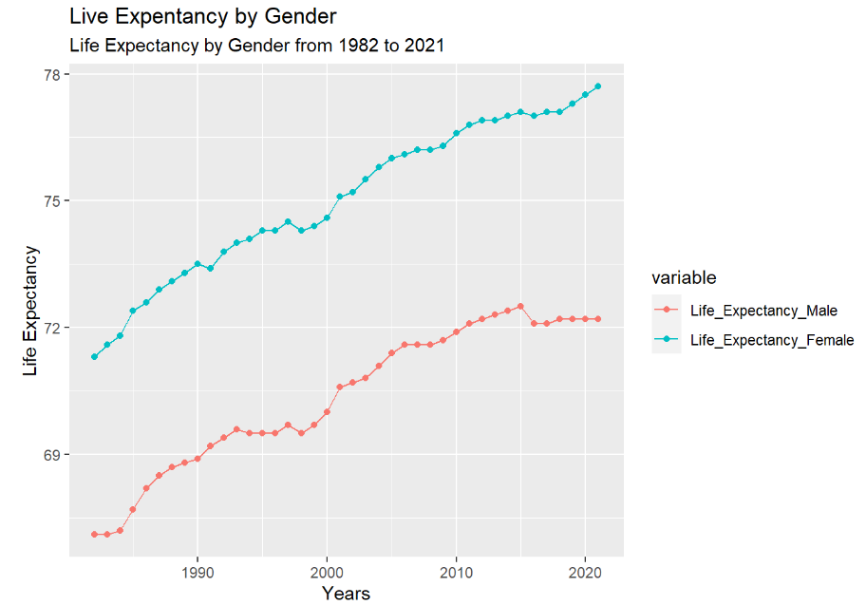
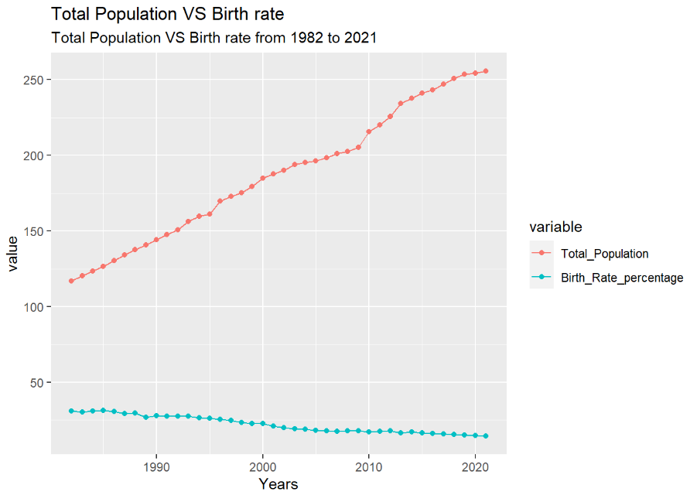
Exploratory Data Analysis (EDA) (3/5)
Male and Female Life Expectancy by Year
Total Population vs Birth Rate
05
06
The Life Expectancy of Female and Male have been increasing since 1982 except for the Male where their Life Expectancy stagnated sine 2015.
The Total Population in Malaysia has been increasing since 1982 but the Birth Rate of Malaysians has slowly decreasing since 1982.

Slide 12
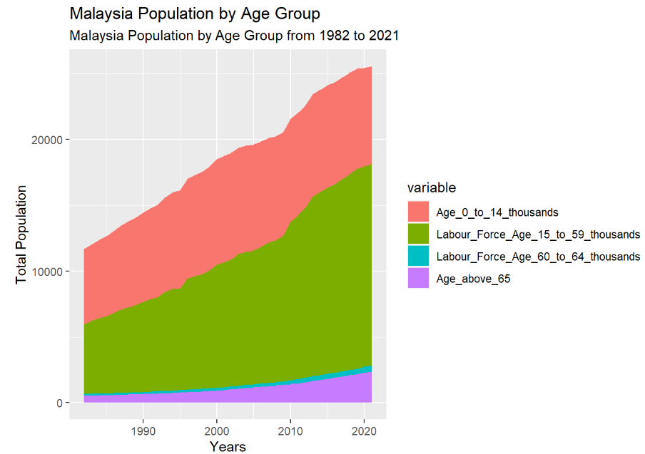
Exploratory Data Analysis (EDA) (4/5)
Malaysia Population by Age Group
07
The Total Malaysian Population age 14 and below is slowly increasing unlike huge increase Malaysian age between 15 to 59, there is slow increase of Malaysian age 60 and above.

Slide 13
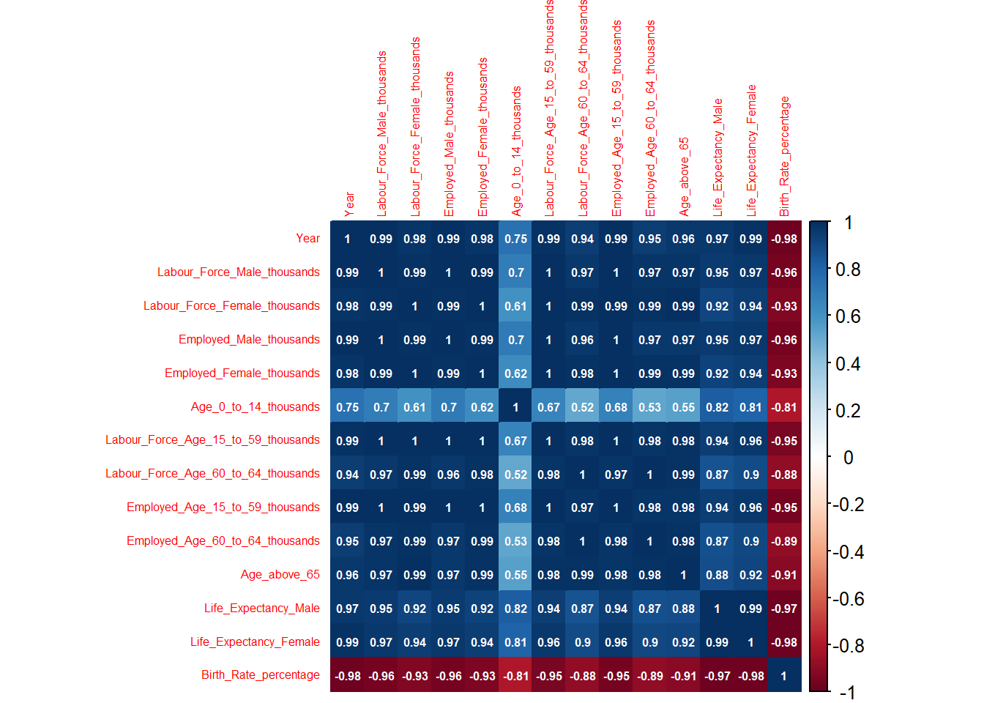
Exploratory Data Analysis (EDA) (4/5)
Malaysia Population by Age Group
07
Birth_Rate_Percentage has negative correlation to every other attributes.

Slide 14
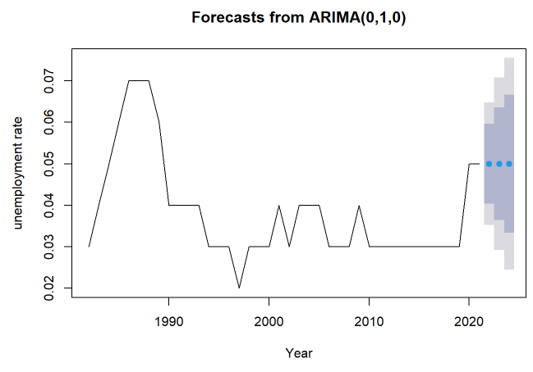
Modeling (1/3)
ARIMA Model
Predict unemployment rate in Malaysia for the year 2022 until 2024.
The colored area shows the forecast results for 2022, 2023 and 2024, with light gray area indicating 95% confidence region (95% probability that the forecast results will fall in this range), dark gray area indicating 80% confidence region, and blue dots indicating the average.
Increased
Unemployment Rate
Forecast from ARIMA model showed that the unemployment rate in Malaysia for the year 2022, 2023 and 2024 will be increased by ~0.05%.

Slide 15
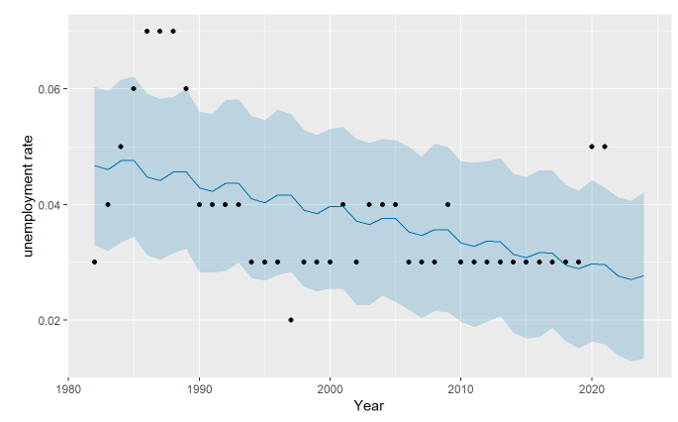
Modeling (2/3)
Prophet Model
Predict unemployment rate in Malaysia for the year 2022 until 2024.
Unreliable model
When using the prophet model, we can see from the figure that the effect of the model fitting the data is very poor, and there is a risk in using this model as the unemployment rate.

Slide 16
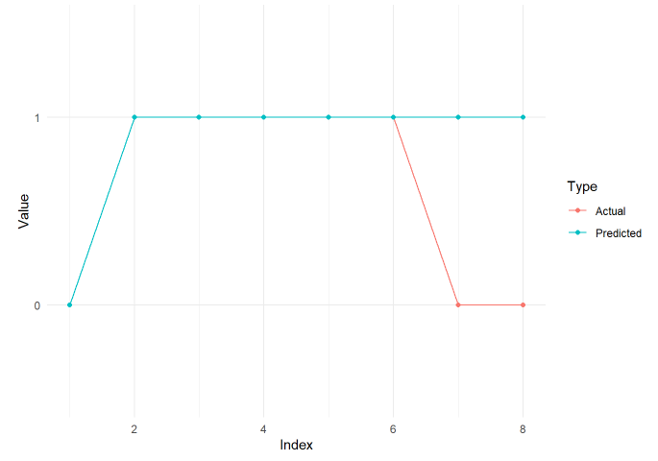
Modeling (3/3)
Random Forest
Predict growth rate of aging workforce in Malaysia from 2022 until 2024.
Growing Trend of
Aging Workforce
Forecast from Random Forest showed that the growth rate of aging workforce in Malaysia will increase for the year 2022, 2023 and 2024.

Slide 17

Discussion (1/2)
01
Does the model prove if there is a trend of aging workforce in Malaysia?
02
Which model performs better for
time-series data?
The Random Forest Classifier model proves that there is a trend of aging workforce in Malaysia. Because according to the model, we can get that aging workforce is appearing more frequently.
Trend of our unemployment rate data is unstable. ARIMA model performs better because of:
Adaptive capacity to handle non-stationary of the data.
Capture trends and seasonal patterns in the data and forecast accordingly.
Provide confidence intervals on forecast results - useful for dealing with forecasts of unstable data.
VS
Prophet model has some disadvantages in dealing with non-stationary data.
Use a predefined trend and seasonal model and may not be flexible enough to accommodate certain complex non-linear trends or seasonal patterns.

Slide 18
Discussion (2/2)
03
What is the increase in percentage of unemployment rate in Malaysia?
In the next three years, according to ARIMA model, unemployment rate will be increased by ~0.05%.
04
What are the proposed mitigation measures on the aging workforce in Malaysia?
Extending the retirement age:
This measure facilitates knowledge retention and transfer, allowing older workers to share their valuable experience and expertise with younger colleagues. It prevents the loss of critical knowledge and ensures a smooth succession planning process.
Promoting age-inclusive recruitment and retention practices:
This approach encourages employers to value and employ workers of all ages, fostering diversity and intergenerational collaboration between older and younger employees.
Providing lifelong learning and training:
This initiative helps older workers update their skill sets and adapt to the constant changes in the industry. By enhancing the employability and productivity of older workers, it reduces the risk of unemployment.

Slide 19

Conclusion
An ageing workforce isn't a burden. It's an opportunity.
It is important to take care of the welfare of aging workforce as it helps to promote economic stability by minimizing the risks of unemployment and skills gaps in the aging workforce.
It creates a positive social environment where individuals are valued regardless of their age and reduces age-related discrimination. This leads to better knowledge retention and transfer and prevent loss of critical knowledge.
It enables us to harness the potentials from older workers and create an inclusive and sustainable labor markets.

